Slide 1
IPSec
Network Layer Security
Shahla Shaan Ahmed BSSE 810
Tulsi Chandra Das BSSE 811
Maloy Kanti Sarkar BSSE 834
Taslima Binte Kamal BSSE 835

Slide 2
What is IPSec?
A Framework of open standards to ensure secure communications over the Internet.

Slide 3
IPSec Defines:
The architecture for security services for IP network traffic.
The framework for providing security at the IP layer.
The suite of protocols designed to provide security, through authentication and encryption of IP network packets.
The cryptographic algorithms used to encrypt, decrypt and authenticate packets.
The protocols needed for secure key exchange and key management.

Slide 4
IPSec Mechanism
General IP Security mechanisms provides
Authentication
Confidentiality
Connectionless integrity
Replay protection

Slide 5
IPsec Application
IPSec provides the capability to secure communications across a LAN, across private and public WANs, and across the Internet.
Secure branch office connectivity over the Internet
Secure remote access over the Internet
Establishing extranet and intranet connectivity with partners
Enhancing electronic commerce security

Slide 6
Benefits of IPSec
In a firewall/router provides strong security to all traffic crossing the perimeter
In a firewall/router is resistant to bypass
Is below transport layer, hence transparent to applications
Can be transparent to end users
Can provide security for individual users

Slide 7
Network Layer Security
IP security (IPsec)
Two protocols
Authentication protocol, using an Authentication Header (AH)
Encryption/authentication protocol, called the Encapsulating Security Payload (ESP)
Two modes of operation
Transport mode: provides protection for upper-layer protocols
Tunnel mode: protects the entire IP datagram

Slide 8
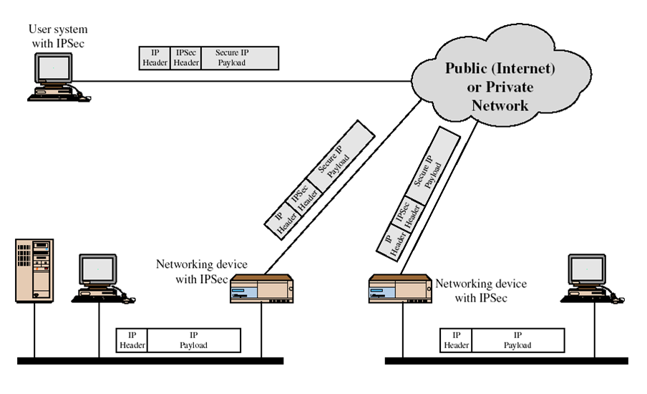
IP security scenario

Slide 9
IPSec Documents
specification is quite complex, with groups:
Architecture
RFC4301 Security Architecture for Internet Protocol
Authentication Header (AH)
RFC4302 IP Authentication Header
Encapsulating Security Payload (ESP)
RFC4303 IP Encapsulating Security Payload (ESP)
Internet Key Exchange (IKE)
RFC4306 Internet Key Exchange (IKEv2) Protocol
Cryptographic algorithms
Other

Slide 10
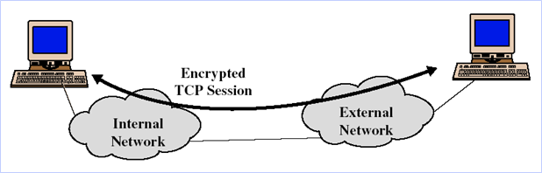
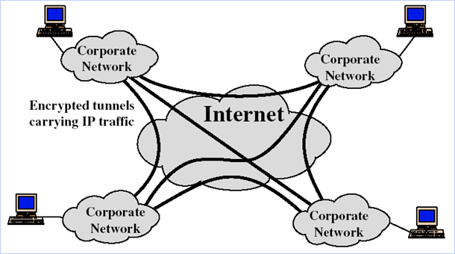
Transport Mode
Tunneling Mode

Slide 11
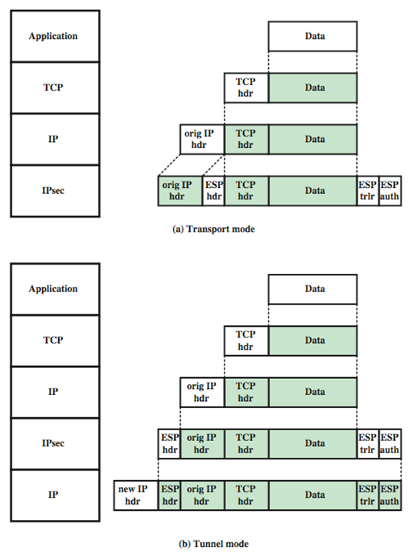
Transport
and
Tunnel Mode
Protocols

Slide 12
Security Associations
a one-way relationship between sender & receiver that affords security for traffic flow
defined by 3 parameters:
Security Parameters Index (SPI)
IP Destination Address
Security Protocol Identifier
has a number of other parameters
seq no, AH & EH info, lifetime etc
have a database of Security Associations

Slide 13
Security Association Database
Security Parameter Index
Sequence Number Counter
Sequence Counter Overflow
Anti-Replay Window
AH Information
ESP Information
Lifetime of this Security Association
IPsec Protocol Model
Path MTU

Slide 14
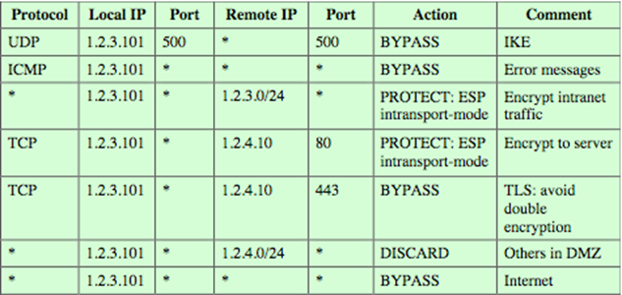
Security Policy Database
relates IP traffic to specific SAs
match subset of IP traffic to relevant SA
use selectors to filter outgoing traffic to map
based on: local & remote IP addresses, next layer protocol, name, local & remote ports

Slide 15
Encapsulating Security Payload (ESP)
provides message content confidentiality, data origin authentication, connectionless integrity, an anti-replay service, limited traffic flow confidentiality
services depend on options selected when establish Security Association (SA), net location
can use a variety of encryption & authentication algorithms

Slide 16
Encryption & Authentication Algorithms & Padding
ESP can encrypt payload data, padding, pad length, and next header fields
if needed have IV at start of payload data
ESP can have optional ICV for integrity
is computed after encryption is performed
ESP uses padding
to expand plaintext to required length
to align pad length and next header fields
to provide partial traffic flow confidentiality

Slide 17
Anti-Replay Service
replay is when attacker resends a copy of an authenticated packet
use sequence number to thwart this attack
sender initializes sequence number to 0 when a new SA is established
increment for each packet
must not exceed limit of 2³² – 1
receiver then accepts packets with seq no within window of (N –W+1)

Slide 18
IPSec Key Management
handles key generation & distribution
typically need 2 pairs of keys
2 per direction for AH & ESP
manual key management
sysadmin manually configures every system
automated key management
automated system for on demand creation of keys for SA’s in large systems
has Oakley & ISAKMP elements

Slide 19
Oakley
a key exchange protocol
based on Diffie-Hellman key exchange
adds features to address weaknesses
no info on parties, man-in-middle attack, cost
so adds cookies, groups (global params), nonces, DH key exchange with authentication
can use arithmetic in prime fields or elliptic curve fields

Slide 20
ISAKMP
Internet Security Association and Key Management Protocol
provides framework for key management
defines procedures and packet formats to establish, negotiate, modify, & delete SAs
independent of key exchange protocol, encryption alg, & authentication method
IKEv2 no longer uses Oakley & ISAKMP terms, but basic functionality is same

Slide 21
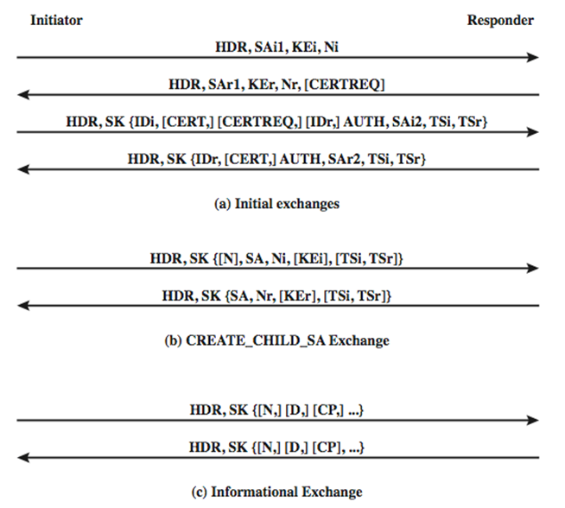
IKEV2 Exchanges

Slide 22
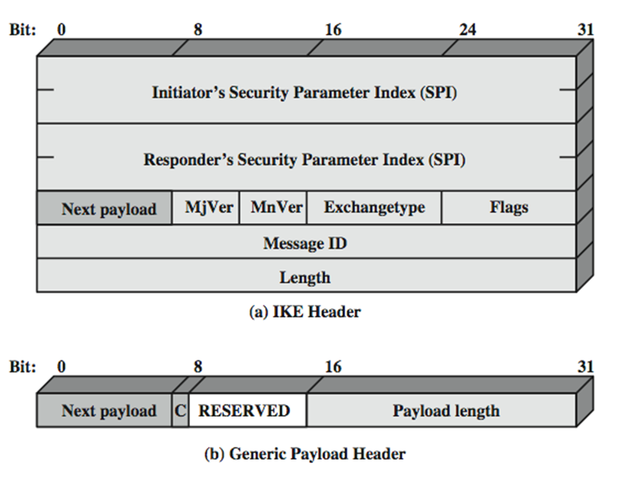
ISAKMP

Slide 23
Reference
[1] https://www.simplilearn.com/understanding-ipsec-rar37-article, Last accessed on 20th October, 2019

Slide 24
Thank You!

